Slide 1
Code Kraken - Hackathon
Team Name - STME Coders
Team Members -
Akshat Kumarey Sabhya Jaiswal
Divyansh Bohra Sahil Sinha

Slide 2
Problem Definition
Time table management and generation is a very tedious job which can be very tasking for people to manually tackle.
Even people who have never tried to make a time table, let alone multiple time tables for multiple classes and equally numerous teachers, can understand why it must be such a tough objective.
All in all, it takes way more time and efforts from people to make time tables than required, while that time and energy could be used more practically, where it is more needed.

Slide 3
It is also seen that many times, if a lecture is not held for whatever reason, there needs to be a pendency scheduled for that lecture to ensure that the number of lectures in the semester get taken without a hassle near the end of the term.
Also, surplus lectures are taken at times during free periods for the same reasons. This also gets increasingly tough for both the professors and the class reps to coordinate and work around.

Slide 4
Solution
To solve this problem, we have come up with a seemingly obvious answer: to make our computer do it. We will simply be using python, pandas, numpy as well as tkinter for a little bit of frontend attractiveness to create a time table generator.
The program will follow multiple algorithms to effectively plug in lectures during the times of the day depending on the credits of the subject (number of lectures per week for that subject) and the number of lectures to be held for a particular class each day.
The user will merely have to input the names of the subjects and their credits for each class, and the program will return with time tables for all the classes as well as all the teachers (subjects)

Slide 5
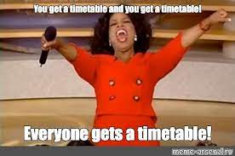

The pendencies/surplus classes will also be plugged in the free spots (mostly on Mondays, which are dedicated to pendencies or extra classes) if needed by just one input giving the program the details of the missed/extra class.

Slide 6
Techstack
Python: Python as the programming language. Python is a general-purpose language that is well-suited for developing a variety of applications, including timetable makers. It is easy to learn and use, and there are a wide range of libraries and frameworks available to help with development.
Pandas: Pandas is a library for data analysis and manipulation.
Numpy: NumPy is a library for handling multidimensional arrays.
Tkinter: Tkinter is a standard Python library for creating graphical user interfaces (GUIs) with a native look and feel across different platforms, providing widgets and tools for building interactive desktop applications.
Random: The random library in Python provides functions for generating random numbers and performing random operations, such as randomizing sequences and selecting random elements from collections.

Slide 7
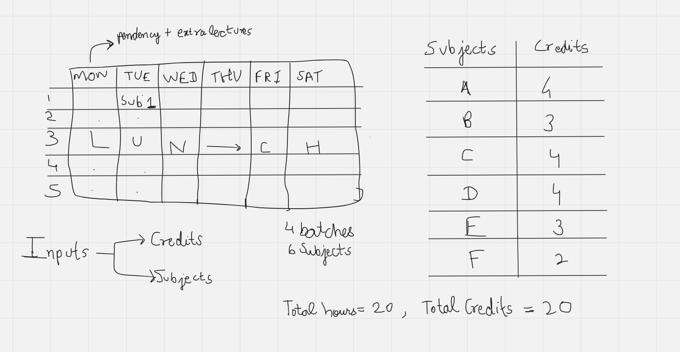
Architecture

Slide 8

We will be using lists (and nested lists) to implement the subject names and the credits for each subject for each class. For example, ClassA = [ ["sub1", 3], ["sub2", 2]...]. Using these lists for each class along with the random library, we will insert lectures into our time table database. Then, we will decrement the number of credits in the list to ensure that extra lectures aren't held. These loops will go on until all credits for all subjects are decremented to zero.
To implement pendencies/surplus lectures we will ask the user to input the subject and the day of the week when a lecture is not being held. We will take count of the total pendencies of said subject and schedule them on Monday, which is designated for extra lectures and pending classes

